Slide 1


DIGITAL BRIEF
TEMPLATE

Slide 2

This template is provided for free for personal and educational use. All copyright and intellectual property rights are retained by VANESSA SANGARI. You are not permitted to redistribute commercially, or sell this template without explicit permission from the author. While you may use it to enhance your personal learning experience and projects, please ensure to credit the original source when appropriate. For any inquiries regarding use, please contact support@vanessasangari.com
Thank you for respecting these terms!

Slide 3
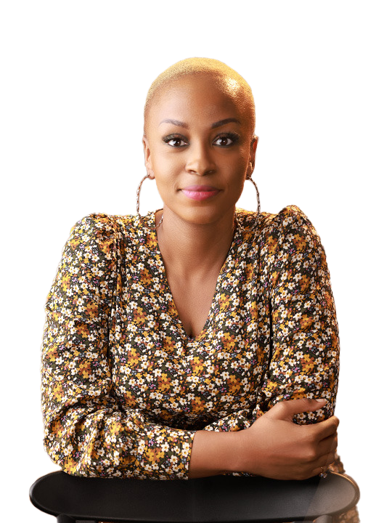
Hi There!
Thanks for downloading this PowerPoint ☺ .
This is an editable file. You can edit and create your version by adding and removing elements you either desire or do not desire.

Slide 4
LET’S GET STARTED
DIGITAL BRIEF
TEMPLATE
NB: There are comments in this ppt

Slide 5
SAMPLE
DIGITAL BRIEFING
DOCUMENT
[ADD DATE HERE]

Slide 6
DIGITAL GOALS
GOAL 1
GOAL 2
GOAL 3

Slide 7
DIGITAL ECOSYSTEM AND EXECUTION APPROACH
INSTRUCTION
What are the digital channels you would be leveraging and how?

Slide 8
DIGITAL OBJECTIVE SPLIT
REACH
ENGAGEMENT
TRAFFIC
X%
X%
X%
Posts created for driving awareness
Posts created for driving audience engagement
Posts created to drive audience to click through to a landing page

Slide 9
SAMPLE DIGITAL EXECUTION SCHEDULE: MAR 2025
MON | TUE | WED | THU | FRI | SAT | SUN
 |  |  |  |  | 1st Mar | 2nd Mar
3rd Mar | 4th Mar | 5th Mar | 6th Mar | 7th Mar | 8th Mar | 9th Mar
 | E.g. REACH |  |  | E.g. ENG
10th Mar | 11th Mar | 12th Mar | 13th Mar | 14th Mar | 15th Feb | 16th Mar
17th Mar | 18th Mar | 19th Mar | 20th Mar | 21st Mar | 22nd Mar | 23rd Mar
 |  |  |  |  | ENG
24th Mar | 25th Mar | 26th Mar | 27th Mar | 28th Mar | 29th Mar | 30th Mar
31st Mar
Key date: EID-UL-FITR

Slide 10

CONTENT REQUIREMENTS

Slide 11
ASSET LIST
INSTRUCTION
What are the different creative assets you need?
How many of them do you need?
In what formats do you need them in?
In what dimensions do you need them in?
Are there any specific rules your team should follow or be mindful of as they create the assets for this?

Slide 12

EG. FACEBOOK COVER
Size: 820 x 312 pixels
Recommended: Use JPG format, Use RGB color, Keep the file size under 100 KB, and Use a PNG file to avoid quality loss

Slide 13
POST 1
OBJECTIVE: REACH
Date: Tuesday 4th March 2025

Slide 14
POST 2
OBJECTIVE: ENGAGEMENT
Date: Friday 7th March 2025

Slide 15
Thank you!
www.vanessangari.com

