Slide 1


DIGITAL BRIEF
TEMPLATE

Slide 2

This template is provided for free for personal and educational use. All copyright and intellectual property rights are retained by VANESSA SANGARI. You are not permitted to redistribute commercially, or sell this template without explicit permission from the author. While you may use it to enhance your personal learning experience and projects, please ensure to credit the original source when appropriate. For any inquiries regarding use, please contact support@vanessasangari.com
Thank you for respecting these terms!

Slide 3
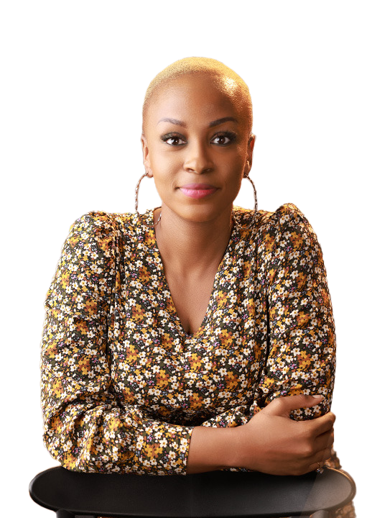
Hi There!
Thanks for downloading this PowerPoint ☺ .
This is an editable file. You can edit and create your version by adding and removing elements you either desire or do not desire.

Slide 4
LET’S GET STARTED
DIGITAL BRIEF
TEMPLATE
NB: There are comments in this ppt

Slide 5

KEY TAKEOUTS FROM DIGITAL STRATEGY

Slide 6
OVERVIEW
E.G. A DIGITAL CONTENT FOR THE MONTH OF MARCH
Digital content for the month of March centered around the launch of our new product offering, to be executed across [state channels], starting from [state date] to [state date]. The campaign aims to [E.g. increase brand awareness, boost engagement, and drive traffic to a dedicated landing page]

Slide 7
DIGITAL GOALS
GOAL 1:
AWARENESS
E.g. Increase awareness of new product offering by 10%, measurable by online social listening in brand mentions and sentiments.
GOAL 2
[State using input for Goal 1 as an Example]
GOAL 3
[State using input for Goal 1 as an Example]

Slide 8



DIGITAL ECOSYSTEM
E.G. CHANNEL ROLES AND USAGE
Mass awareness platform enabling meaningful interactions between brands and users.
Search and discovery engine that drives targeted traffic and enhances brand visibility through optimized content and advertising
Video-sharing platform that facilitates engaging storytelling and brand awareness through visual content, reaching diverse audiences effectively

Slide 9
DIGITAL EXECUTION APPROACH: META
EXAMPLE:
Create visually appealing posts and stories tailored to TA (Target Audience). E.g. Total of 8-10 posts, Posting days: Tuesdays & Fridays.
Use carousel ads and engaging videos to encourage interaction
Run polls and quizzes in Stories to engage users and gather insights

Slide 10
EG. META DIGITAL OBJECTIVE SPLIT
REACH
ENGAGEMENT
TRAFFIC
50%
35%
15%
Posts created for driving awareness
Posts created for driving audience engagement
Posts created to drive audience to click through to a landing page
**Percentages are only estimates

Slide 11
SAMPLE DIGITAL EXECUTION SCHEDULE: MAR 2025
MON | TUE | WED | THU | FRI | SAT | SUN
 |  |  |  |  | 1st Mar | 2nd Mar
3rd Mar | 4th Mar | 5th Mar | 6th Mar | 7th Mar | 8th Mar | 9th Mar
 | REACH |  |  | ENGAGEMENT
10th Mar | 11th Mar | 12th Mar | 13th Mar | 14th Mar | 15th Feb | 16th Mar
 | TRAFFIC |  |  | REACH
17th Mar | 18th Mar | 19th Mar | 20th Mar | 21st Mar | 22nd Mar | 23rd Mar
 | ENGAGEMENT |  |  | REACH
24th Mar | 25th Mar | 26th Mar | 27th Mar | 28th Mar | 29th Mar | 30th Mar
 | ENGAGEMENT |  |  | REACH
31st Mar

Slide 12
DIGITAL EXECUTION APPROACH: GOOGLE
EXAMPLE:
Create valuable content (blog posts, guides) that answers user queries and builds authority.
Optimize website content for relevant keywords to improve organic search ranking.
Ensure the website is user-friendly, mobile-responsive, and fast-loading.
Utilize retargeting ads to reach users who have previously interacted with the brand.

Slide 13
DIGITAL EXECUTION APPROACH: YOUTUBE
EXAMPLE:
Utilize formats like tutorials, behind-the-scenes, or customer testimonials to tell campaign story.
Optimize video titles, tags, and descriptions for searchability. Include calls to action.
Host live Q&A sessions or webinars to engage directly with the audience.
Monitor YouTube Analytics for views, watch time, and engagement rates to refine future video content.

Slide 14
DIGITAL CONTENT REQUIREMENTS

Slide 15
ASSET LIST
INSTRUCTION
What are the different creative assets you need?
How many of them do you need?
In what formats do you need them in?
In what dimensions do you need them in?
Are there any specific rules your team should follow or be mindful of as they create the assets for this?

Slide 16
ASSET LIST EXAMPLE
EXAMPLE: META: FACEBOOK & INSTAGRAM
Facebook cover photo -
Facebook and Instagram Page Posts - 9

Slide 17

EG. FACEBOOK COVER
Size: 820 x 312 pixels
Recommended: Use JPG format, Use RGB color, Keep the file size under 100 KB, and Use a PNG file to avoid quality loss

Slide 18
POST #
OBJECTIVE: [STATE]
Date: [State]
INSTRUCTION
On slides like these, you want the reader to know what the objective of the post is (informs CTA usage) and other details like the day and date the post will go up, etc.

Slide 19
POST 1
OBJECTIVE: REACH
Date: Tuesday 4th March 2025

Slide 20
POST 2
OBJECTIVE: ENGAGEMENT
Date: Friday 7th March 2025

Slide 21
POST 1
OBJECTIVE: TRAFFIC
Date: Tuesday 11th March 2025

Slide 22
POST 2
OBJECTIVE: REACH
Date: Friday 14th March 2025

Slide 23
POST 1
OBJECTIVE: ENGAGEMENT
Date: Tuesday 18th March 2025

Slide 24
POST 2
OBJECTIVE: REACH
Date: Friday 21st March 2025

Slide 25
POST 1
OBJECTIVE: ENGAGEMENT
Date: Tuesday 25th March 2025

Slide 26
POST 2
OBJECTIVE: REACH
Date: Friday 28th March 2025

Slide 27
Thank you!
www.vanessangari.com

